Slide 1
BASIC WORKFLOW:

Slide 2
Local
Remote

Slide 3


Local
Remote
Local Git
Remote Git
Git tracks the changes we make to files on our local machine, e.g. our computer.
Git allows us to store our files and history remotely which can then be accessed on other devices.

Slide 4

Local
Remote
Local Repo
Remote Repo
Git Repository
This is where Git tracks and records all the changes made to the files in our project.

Slide 5


Local
Remote
Working Directory
Local Repo
Remote Repo
Working Directory
This is the location in which we work and save our files.

Slide 6

Local
Remote
Working Directory
Local Repo
Remote Repo
Staging Area
git add
Staging Area
Any changes we make to a file that we want Git to track we first add to the staging area using the command git add

Slide 7

Local
Remote
Working Directory
Local Repo
Remote Repo
Staging Area
git add
git commit
Commit Changes
We can then commit any changes in the staging area using the command git commit

Slide 8

Local
Remote
Working Directory
Local Repo
Remote Repo
Staging Area
git add
git commit
git push
Push to Remote Repo
We can push any new changes committed in our local repo to the remote repo using the command git push

Slide 9

Local
Remote
Working Directory
Local Repo
Remote Repo
Staging Area
Pull from Remote Repo
git add
Similarly, we can update and merge with our local repo by pulling from the remote repo using the command git pull
git commit
git push
git pull

Slide 10

Local
Remote
Working Directory
Local Repo
Remote Repo
Staging Area
git add
git commit
git push
Working on a Branch
git pull
It is good practice to use branching: to work on a particular branch we use the command git checkout
git checkout

Slide 11
Local
Remote
Working Directory
Local Repo
Remote Repo
Staging Area
git add
git commit
git push
git pull
git checkout

Slide 12
VISUAL FOR COMMITTING CHANGES

Slide 13
Local
Staging Area
Local Repo
Working Directory
Untracked files:
example.txt

Slide 14
Local
Staging Area
Local Repo
Working Directory
git add
example.txt
new file: example.txt

Slide 15
Local
Staging Area
Local Repo
Working Directory
git commit
example.txt
new file: example.txt
example.txt

Slide 16
Local
Staging Area
Local Repo
Working Directory
example.txt
example.txt

Slide 18
Local
Staging Area
Local Repo
Working Directory
Modified files:
example.txt
example.txt

Slide 19
Local
Staging Area
Local Repo
Working Directory
example.txt
(modified)
git add
modified: example.txt
example.txt

Slide 20
Local
Staging Area
Local Repo
Working Directory
example.txt
(modified)
git commit
modified: example.txt
example.txt

Slide 21
Local
Staging Area
Local Repo
Working Directory
example.txt
(modified)
example.txt
(change made)
example.txt
(previous version)

Slide 22
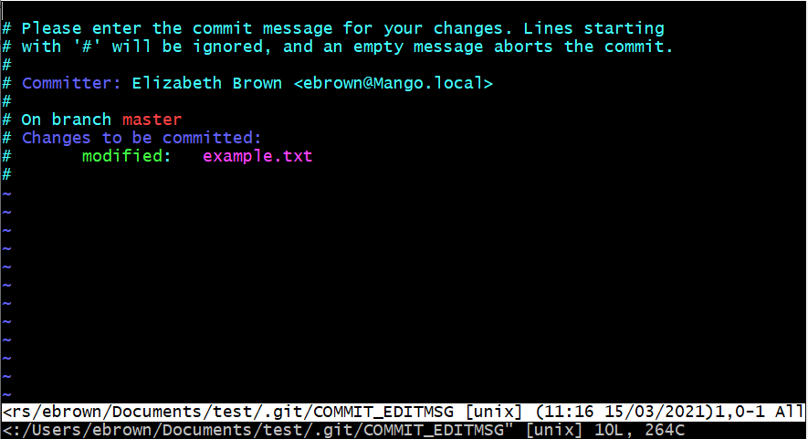
XXXXXXXXXXXXXXXXXXXXXXXXXXXXXXXXXXXXXXXXXXXXXXXXXXXXXXXXXXXXXXXXXXXXXXXXXXXXXXXXXXXXXXXXXXXXXXX
XXXXXXXXXXXXXXXXXXXXXXXXXXXXXXXXXXXXXXXXXXXXXXXXXXXXXXXXXXXXXXXXXXXXXXXXXXXXXXXXXXX

Slide 23
Revert changes workflow

Slide 24
This is the most recent commit which represents the current version of, e.g., a file

Slide 25
We want to revert the file back to its previous version represented by this previous commit

Slide 26
git revert

Slide 27
This new commit represents the changes made in order to revert the file

Slide 28
The file is in the same condition for both these commits

Slide 29
Note that we have not lost any of the file’s commit history

Slide 30
Intro to branching workflow

Slide 31
Development work is being carried out on this branch
development

Slide 32
development
master branch
Git provides a default master branch – it is best practice to avoid working on this branch

Slide 33
Bug fix
Another branch could be created during the project to fix a bug
development
master branch

Slide 34
Bug fix
development
Now there are two pieces of independent development work being carried out alongside each other
master branch

Slide 35
Summary workflow for working on a branch

Slide 36
master
We would like to create a new branch to work on

Slide 37
master
git branch new_branch

Slide 38
master*
new_branch
master* tells us that we are still on the master branch

Slide 39
master*
new_branch
git checkout new_branch

Slide 40
master
new_branch*
Committing a change is now done on new_branch

Slide 41
master
new_branch*
git add ; git commit

Slide 42
new_branch*
“new_branch is ahead of master branch by 1 commit”
master

Slide 43
Introduction to merging workflow

Slide 44
new_branch
master*
We would like to merge the branch new_branch into the master branch

Slide 45
new_branch
master*
We would like to merge the branch new_branch into the master branch
To do this we need to be on the master branch, which we are, indicated by master*

Slide 46
new_branch
master*
git merge finds a common commit and merges the branches from there

Slide 47
new_branch
master*
Common commit
git merge finds a common commit and merges the branches from there

Slide 48
git merge new_branch

Slide 49
new_branch
master*
Merge commit
Now we have a merge commit on the master branch

Slide 50
new_branch
Finally, we want new_branch to point to the merge commit as well
master*
Merge commit

Slide 51
new_branch
master*
git checkout new_branch
git merge master

Slide 52
Master
new_branch*

Slide 53
Complex example of merging

Slide 54
BugFix
We would like to merge all of our work onto the master branch
master*
development

Slide 55
BugFix
First we merge the branch BugFix into the branch development
master*
development

Slide 56
BugFix
git checkout development
git merge BugFix
git checkout BugFix
git merge development
master*
development

Slide 57
development
BugFix*
master

Slide 58
Next we merge the branch development into the branch master
development
BugFix*
master

Slide 59
git checkout master
git merge development
git checkout development
git merge master
development
BugFix*
master

Slide 60
The BugFix branch is still pointing to the previous commit so we can finish with a fast-forward merge
BugFix
development
master*

Slide 61
git checkout BugFix
git merge master
BugFix
development
master*

Slide 62
development
master
BugFix*

